Slide 1

Proiect pia blackjack
Proiect realizat de
Bercuci Mihaela
Militaru Răzvan
Tarbă Alessia-Melissa

Slide 2
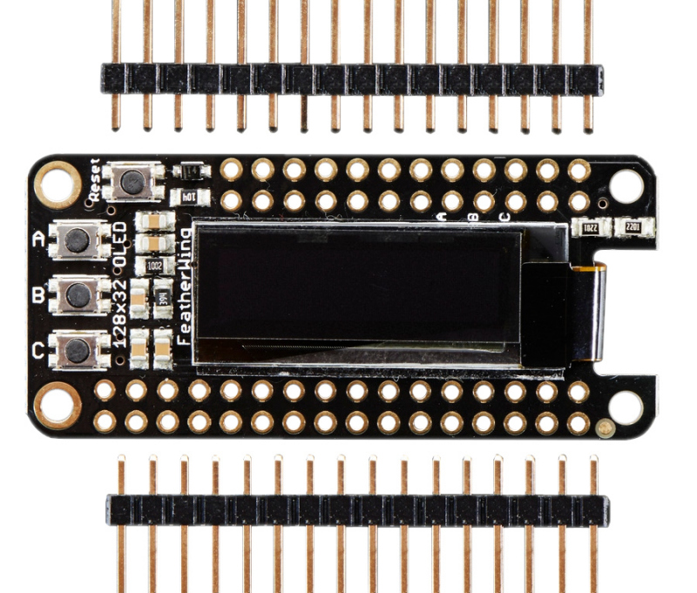
componente
Shield FeatherWing cu Ecran OLED 128 x 32 pentru Adafruit Feather

Slide 3
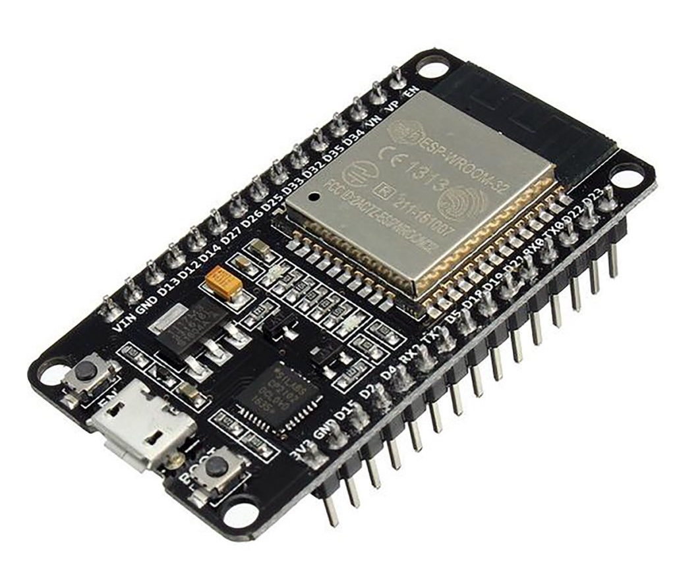
componente
ESP 32

Slide 4
cod
#include <Wire.h>
#include <Adafruit_GFX.h>
#include <Adafruit_SSD1306.h>
#define SCREEN_WIDTH 128
#define SCREEN_HEIGHT 64
#define OLED_RESET -1
#define SCREEN_ADDRESS 0x3C
#define I2C_SDA 32
#define I2C_SCL 33
#define BTN_HIT 25
#define BTN_STAND 26
#define BTN_RESET 27
Adafruit_SSD1306 display(SCREEN_WIDTH, SCREEN_HEIGHT, &Wire, OLED_RESET);
int playerScore = 0;
int dealerScore = 0;
bool playerDone = false;
bool gameEnded = false;
int drawCard() {
return random(2, 11);
}
void showText(String line1, String line2 = "", String line3 = "") {
display.clearDisplay();

Slide 5
cod
display.setTextSize(1);
display.setTextColor(SSD1306_WHITE);
display.setCursor(0, 0);
display.println(line1);
if (line2 != "") display.println(line2);
if (line3 != "") display.println(line3);
display.display();
}
void resetGame() {
playerScore = drawCard() + drawCard();
dealerScore = drawCard() + drawCard();
playerDone = false;
gameEnded = false;
showText("BLACKJACK",
"You: " + String(playerScore),
"25=Hit 26=Stand");
}
void setup() {
Serial.begin(115200);
Wire.begin(I2C_SDA, I2C_SCL);
randomSeed(analogRead(0));
pinMode(BTN_HIT, INPUT_PULLUP);
pinMode(BTN_STAND, INPUT_PULLUP);
pinMode(BTN_RESET, INPUT_PULLUP);
if (!display.begin(SSD1306_SWITCHCAPVCC, SCREEN_ADDRESS)) {

Slide 6
cod
Serial.println(F("Eroare OLED"));
while (1);
}
resetGame();
}
void loop() {
if (!playerDone) {
if (digitalRead(BTN_HIT) == LOW) {
delay(200);
int card = drawCard();
playerScore += card;
Serial.println("HIT: " + String(card));
if (playerScore > 21) {
playerDone = true;
gameEnded = true;
showText("You BUST!",
"Score: " + String(playerScore),
"27=Reset");
} else {
showText("You: " + String(playerScore),
"25=Hit 26=Stand");
}
}
if (digitalRead(BTN_STAND) == LOW) {

Slide 7
cod
delay(200);
playerDone = true;
while (dealerScore < 17) {
dealerScore += drawCard();
}
String result;
if (dealerScore > 21 || playerScore > dealerScore)
result = "🏆 You win!";
else if (playerScore < dealerScore)
result = "💀 Dealer wins!";
else
result = "🤝 Draw";
showText("You: " + String(playerScore),
"Dealer: " + String(dealerScore),
result + " | 27=Reset");
gameEnded = true;
}
}
if (gameEnded && digitalRead(BTN_RESET) == LOW) {
delay(300);
resetGame();
}
}

